Slide 1
IDA – Information Retrieval
prof. Anna Wilbik

Slide 2
Course overview
Introduction to DS & AI
What is AI?
Exploratory Data Analysis
Agents
Data Mining
Search
Mathematical Modeling
Logic
Mathematical Simulations
Learning
Game Theory
Information Retrieval
Computer Class
Ethics in AI
Notes:
Data transfered into knowledge useful to humans

Slide 3
Announcements
Computer Class – next Monday
Bring your laptop!
Ethics in AI – please prepare for the Oxford debate – next Tuesday
See which team you are in.
Sign up for your team on canvas.
Amongst your teammates decide on 3 people who will take the following roles;
Principal speaker
Secondary speaker
Question collector
Research the topic - find arguments for/against the statement, depending on which side you have been assigned to argue.
Share your research with your team using Canvas.
Tutorial – next Thursday

Slide 4
Course overview
Introduction to DS & AI
What is AI?
Exploratory Data Analysis
Agents
Data Mining
Search
Mathematical Modeling
Logic
Mathematical Simulations
Learning
Game Theory
Information Retrieval
Computer Class
Ethics in AI
Notes:
Data transfered into knowledge useful to humans

Slide 5
Information Retrieval
Information Retrieval (IR) is finding material (usually documents) of an unstructured nature (usually text) that satisfies an information need from within large collections (usually stored on computers).
web search
e-mail search
searching your laptop
corporate knowledge bases
legal information retrieval

Slide 6
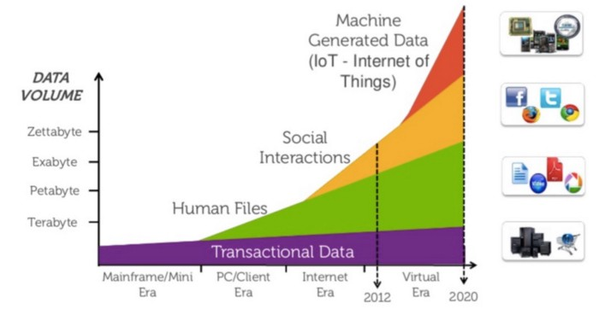
Growth in unstructured data
https://medium.com/@melodyucros/ladyboss-heres-why-you-should-study-big-data-721b04b8a0ca
Notes:
20-80% of data stored by companies unstructured

Slide 7
Basic assumptions of Information Retrieval
Sec. 1.1
Collection: A set of documents
Assume it is a static collection for the moment
Goal: Retrieve documents with information that is relevant to the user’s information need and helps the user complete a task

Slide 8
The classic search model
Task
Misconception?
Info need
Misformulation?
Query
Search engine
Corpus
Query refinement
Results

Slide 9
How good are the retrieved docs?
Sec. 1.1
Precision : Fraction of retrieved docs that are relevant to the user’s information need
Recall : Fraction of relevant docs in collection that are retrieved
Precision Recall trade-off

Slide 10
Unstructured data in 1620
Sec. 1.1
Which plays of Shakespeare contain the words Brutus AND Caesar but NOT Calpurnia?
One could try grepping(=linearly scanning) all of Shakespeare’s plays for Brutus and Caesar, then strip out lines containing Calpurnia
Why is that not the answer?
Slow (for large corpora)
Other operations (e.g., find the word Romans near countrymen) not feasible
Ranked retrieval (best documents to return)
Notes:
Grep is line-oriented; IR is document oriented.

Slide 11
Term-document incidence matrices
Sec. 1.1
Brutus AND Caesar BUT NOT Calpurnia
1 if play contains word, 0 otherwise

Slide 12
Incidence vectors
Sec. 1.1
0/1 vector for each term.
To answer query: take the vectors for Brutus, Caesar and Calpurnia (complemented) ➔ bitwise AND.
110100 AND
110111 AND
101111 =
100100

Slide 13
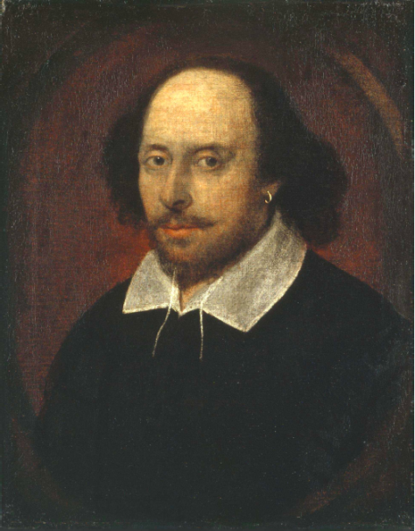
Answers to query
Sec. 1.1
Antony and Cleopatra, Act III, Scene ii
Agrippa [Aside to DOMITIUS ENOBARBUS]: Why, Enobarbus,
When Antony found Julius Caesar dead,
He cried almost to roaring; and he wept
When at Philippi he found Brutus slain.
Hamlet, Act III, Scene ii
Lord Polonius: I did enact Julius Caesar I was killed i’ the
Capitol; Brutus killed me.
Notes:
Wikimedia commons picture of Shake

Slide 14
Bigger collections
Sec. 1.1
Consider N = 1 million documents, each with about 1000 words.
Avg 6 bytes/word including spaces/punctuation
6GB of data in the documents.
Say there are M = 500K distinct terms among these.

Slide 15
Inverted index
Sec. 1.2
For each term t, we must store a list of all documents that contain t.
Identify each doc by a docID, a document serial number
Can we used fixed-size arrays for this?
Posting
Brutus
1
2
4
11
31
45
173
174
Caesar
1
2
4
5
6
16
57
132
Calpurnia
2
31
54
101
Sorted by docID
Dictionary
Postings
What happens if the word Caesar is added to document 14?

Slide 16

Inverted index construction
Sec. 1.2
Documents to
be indexed
Friends, Romans, countrymen.
Token stream
Tokenizer
Friends
Romans
Countrymen
Modified tokens
Linguistic modules
friend
roman
countryman
countryman
13
16
Indexer
2
4
friend
roman
1
2
Inverted index
Notes:
Document icons from free icon set: http://www.icojoy.com/articles/44/

Slide 17
Initial stages of text processing
Tokenization
Cut character sequence into word tokens
Deal with “John’s”, a state-of-the-art solution
Normalization
Map text and query term to same form
You want U.S.A. and USA to match
Stemming
We may wish different forms of a root to match
authorize, authorization
Stop words
We may omit very common words (or not)
the, a, to, of

Slide 18
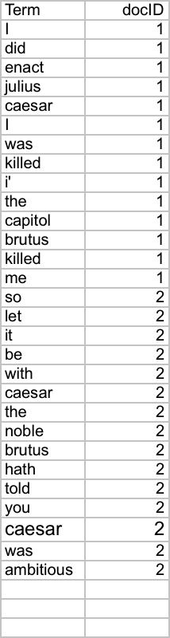
Indexer steps: Token sequence
Sec. 1.2
Sequence of (Modified token, Document ID) pairs.
Doc 1
Doc 2
I did enact Julius
Caesar I was killed
i’ the Capitol;
Brutus killed me.
So let it be with
Caesar. The noble
Brutus hath told you
Caesar was ambitious

Slide 19
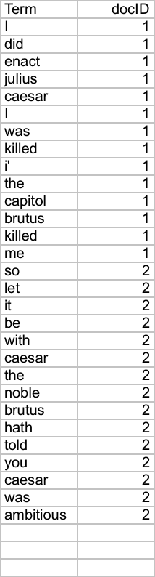
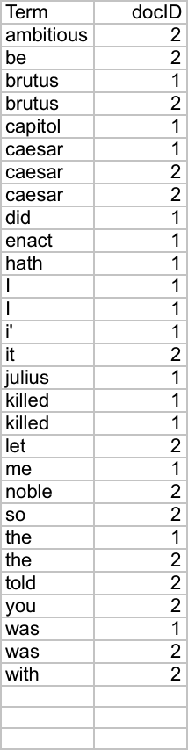
Indexer steps: Sort
Sec. 1.2
Sort by terms and then by docID
Core indexing step

Slide 20
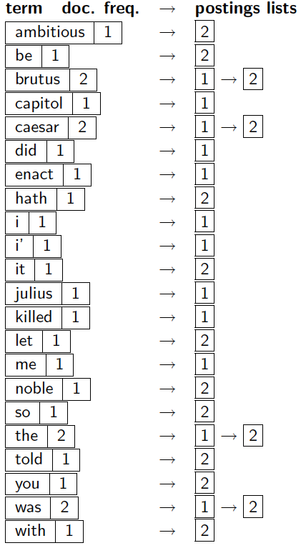
Indexer steps: Dictionary & Postings
Sec. 1.2
Multiple term entries in a single document are merged.
Split into Dictionary and Postings
Doc. frequency information is added.
Why frequency?

Slide 21
Where do we pay in storage?
Sec. 1.2
Lists of docIDs
Terms and counts
IR system implementation
How do we index efficiently?
How much storage do we need?
Pointers

Slide 22
The index we just built
Sec. 1.3
How do we process a query?
Later - what kinds of queries can we process?

Slide 23
Query processing: AND
Sec. 1.3
Consider processing the query:
Brutus AND Caesar
Locate Brutus in the Dictionary;
Retrieve its postings.
Locate Caesar in the Dictionary;
Retrieve its postings.
“Merge” the two postings (intersect the document sets):
2
4
8
16
32
64
128
Brutus
1
2
3
5
8
13
21
34
Caesar

Slide 24
The merge
Walk through the two postings simultaneously, in time linear in the total number of postings entries
2
4
8
16
32
64
128
Brutus
1
2
3
5
8
13
21
34
Caesar
If the list lengths are x and y, the merge takes O(x+y) operations.
Crucial: postings sorted by docID.

Slide 25

The merge: Intersect
Sec. 1.3
Brutus
2
4
8
16
32
64
128
Caesar
1
2
3
5
8
13
21
34
$$∅$$
Brutus AND Caesar
2
8

Slide 26
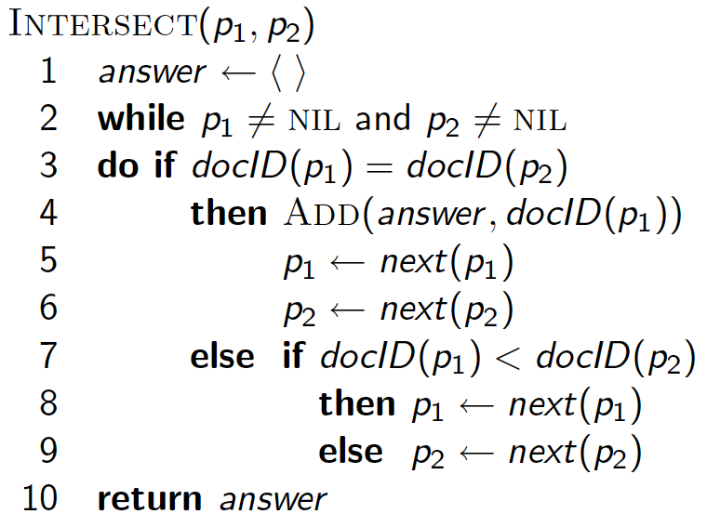
Intersecting two postings lists (a “merge” algorithm)

Slide 27
Exercise
Sec. 1.3
Write out a postings merge algorithm for an x OR y query
Use the previous algorithm as the basis, but take now the union

Slide 28
TASK: Write out a postings merge algorithm for an x OR y query

Slide 29
Solution: Union(p₁, p₂)

Slide 30
Merging
Sec. 1.3
What about an arbitrary Boolean formula?
(Brutus OR Caesar) AND NOT (Antony OR Cleopatra)
Can we always merge in “linear” time?
Linear in what?
Can we do better?

Slide 31
Query optimization
Sec. 1.3
What is the best order for query processing?
Consider a query that is an AND of n terms.
For each of the n terms, get its postings, then AND (=intersect) them together.
Brutus
2
4
8
16
32
64
128
Caesar
1
2
3
5
8
16
21
34
Calpurnia
13
16
Query: Brutus AND Calpurnia AND Caesar

Slide 32
Query optimization example
Sec. 1.3
Process in order of increasing frequencies:
start with smallest set, then keep cutting further.
This is why we kept
document frequencies in dictionary
Brutus
2
4
8
16
32
64
128
Caesar
1
2
3
5
8
16
21
34
Calpurnia
13
16
Execute the query as (Calpurnia AND Brutus) AND Caesar.

Slide 33
More general optimization
Sec. 1.3
e.g., (madding OR crowd) AND (ignoble OR strife)
Get document frequencies for all terms
Estimate the size of each OR by the sum of its document frequencies (conservative)
Process in increasing order of OR sizes

Slide 34
Exercise
Recommend a query processing order for
Which two terms should we process first?
(tangerine OR trees) AND
(marmalade OR skies) AND
(kaleidoscope OR eyes)
tangerine + trees = 46653+316812 = 363465
marmalade + skies = 107913 + 271658 = 379571
kaleidoscope + eyes = 213312 + 87009 = 300321

Slide 35
Query processing exercises
If the query is
friends AND romans AND (NOT countrymen),
how could we use the frequency of countrymen?

Slide 36
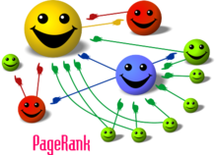
Page Rank
Google became the search engine to use, when they started returning pages not only on their relevance, but also using page rank.
Page rank gives each page a score – you can see these scores if you install the google toolbar. (toolbar.google.com)
Notes:
Once we’ve found all the relevant documents, we now need to know how to order them to present them to the user. To do this Google uses an algorithm called ‘Page Rank’.
Image from Wikipedia

Slide 37
How page rank works
 | A | B | C | D | E
A |  | 1 |  | 1
B |  |  | 1
C |  | 1 |  |  | 1
D |  |  |  |  | 1
E
Rank 100
Page A
50
Page B
Page C
50
?
Page D
50
Page E
Rank 50

Slide 38
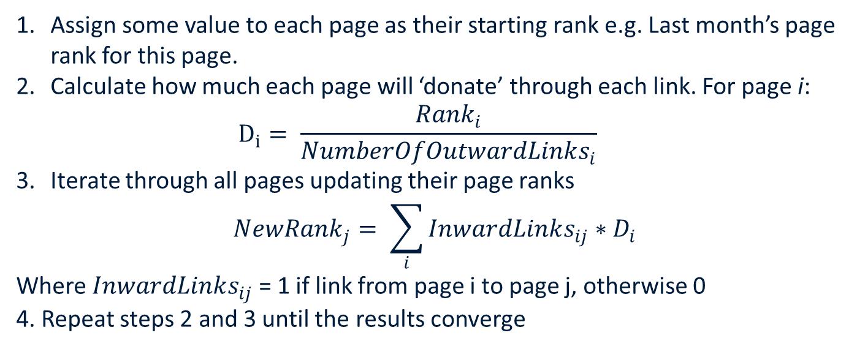
Simplified Page rank algorithm
Assign some value to each page as their starting rank e.g. Last month’s page rank for this page.
Calculate how much each page will ‘donate’ through each link. For page i:
$$D_{i}= \frac{Rank_{i}}{NumberOfOutwardLinks_{i}}$$
Iterate through all pages updating their page ranks
$$NewRank_{j}= \sum_{i}{InwardLinks_{ij}∗D_{i}}$$
Where $InwardLinks_{ij}$ = 1 if link from page i to page j, otherwise 0
4. Repeat steps 2 and 3 until the results converge

Slide 39
Iteration 1
Rank 65
Rank 50
Rank 70
Page B
50
Rank 100
Rank 50
Rank 30
Page A
50
15
Page C
50
70
15
Page D
50
Page E
Rank 50
Rank 50
Rank 70
Rank 65

Slide 40
Iteration 2
What will happen next?
Rank 65
Rank 50
Rank 70
Page B
Rank 100
Rank 50
Rank 30
Page A
Page C
Page D
Page E
Rank 50
Rank 50
Rank 70
Rank 65

Slide 41
Iteration 2
Answer
Rank 65
Rank 50
Rank 70
Page B
65
Rank 100
Rank 50
Rank 30
Page A
35
25
Page C
35
65
25
Page D
50
Page E
Rank 50
Rank 50
Rank 70
Rank 65

Slide 42
Iteration 2
Rank 60
Rank 50
Rank 65
Page B
65
Rank 100
Rank 65
Rank 30
Page A
35
25
Page C
35
65
25
Page D
50
Page E
Rank 50
Rank 35
Rank 70
Rank 75

Slide 43
Convergence
Show it has converged
Rank 66.6
Rank 50
Rank 66.6
Page B
Rank 100
Rank 66.6
Rank 30
Page A
Page C
Page D
Page E
Rank 50
Rank 33.3
Rank 70
Rank 66.6

Slide 44
Other issues
What to do with pages with no inward links?
Google assigns them a small value.
They also setup the weights so the total page rank of all pages (the whole internet) is a constant value, e.g., 1.
For more information read:
http://interestingwebs.blogspot.com/2009/05/simple-explain-of-google-pagerank.html
http://www.sci.utah.edu/~beiwang/teaching/cs1060/Lecture15-PageRankQuizReview.pdf

Slide 45
Exam checklist
Structured vs Unstructured data
Page Rank algorithm
Working with term-document matrices
Postings lists
Building them from documents
Performing simple operations with them (AND, OR)
Ordering queries efficiently

Slide 46
Information Retrieval at DKE
Information Retrieval & Text Mining
Data Structures & Algorithms
Statistics is important

Slide 47
Literature
Introduction to Information Retrieval by Christopher D. Manning, Prabhakar Raghavan and Hinrich Schütze
http://www-nlp.stanford.edu/IR-book/
Read Chapter 1

